Slide 1

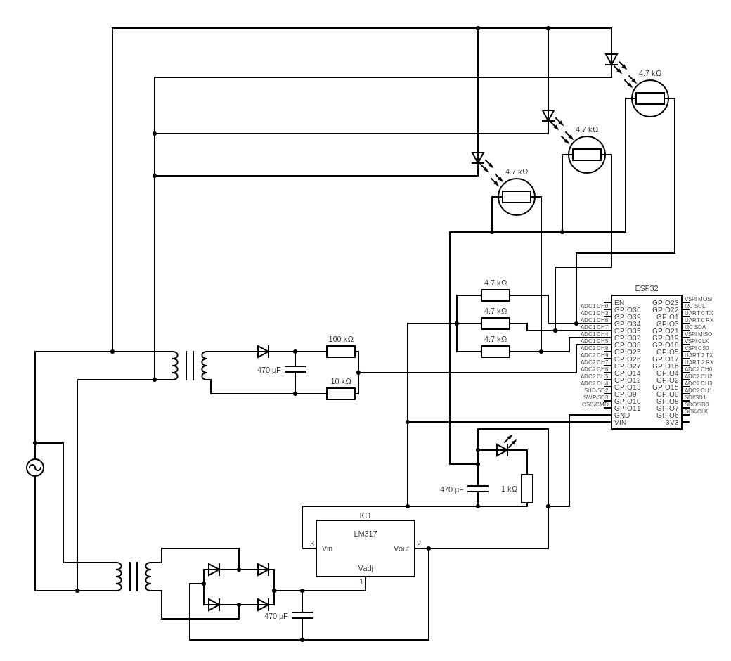
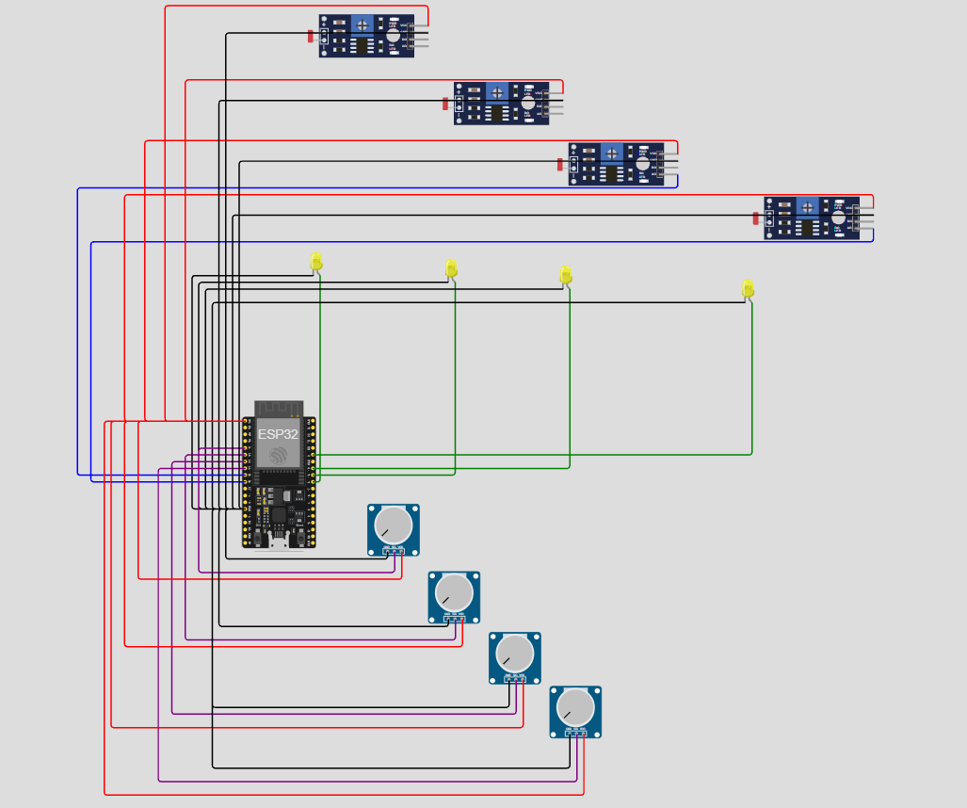
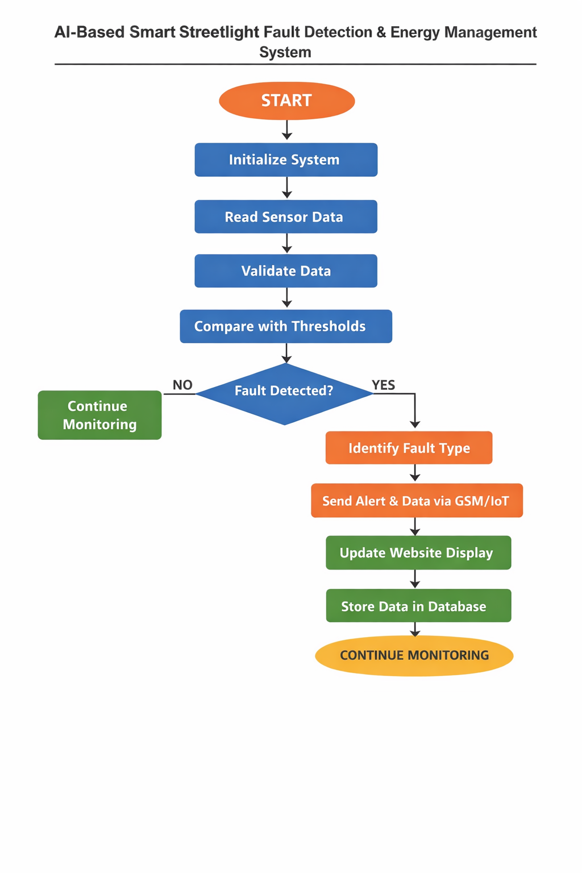
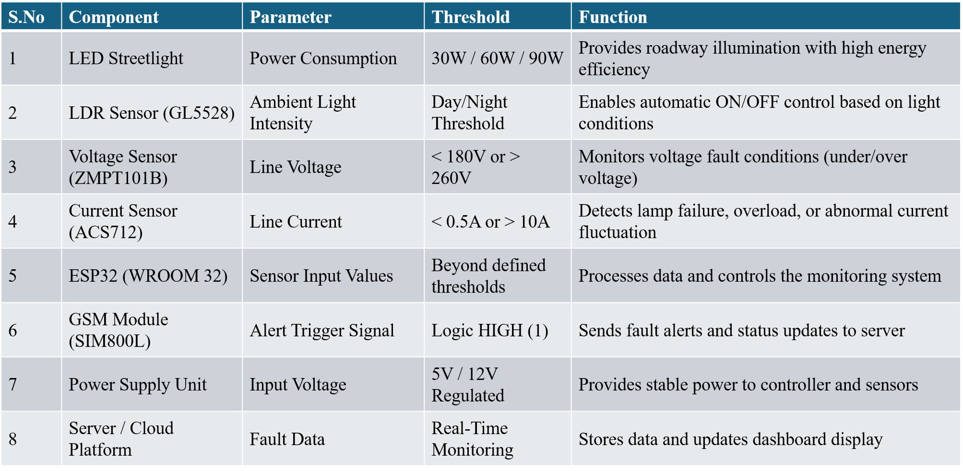
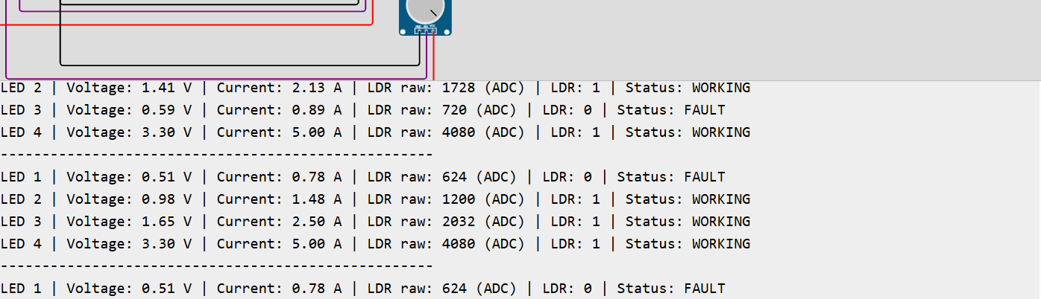
v
Automated Smart Street Light Fault Detection and Responce System
Chandru S, Keerthika T, Prem Arvinth G, Guide: Mr.Mohanasundaram
INTRODUCTION
CIRCUIT DIAGRAM
SIMULATION DIAGRAM
Street lighting is a critical component of urban infrastructure, ensuring safety and visibility. Conventional street lighting systems operate on fixed schedules or manual control, leading to unnecessary energy consumption and delayed fault detection.
With the advancement of IoT and embedded systems, smart street lighting solutions enable real-time monitoring and adaptive control. These systems can automatically adjust lighting based on environmental conditions and detect failures instantly, improving efficiency and reducing maintenance costs.
This project focuses on designing an intelligent street light monitoring system that enhances energy efficiency, enables remote monitoring, and ensures reliable operation.
OBJECTIVES
Develop an automated street light system that monitors and controls lighting based on environmental conditions.
Implement real-time fault detection and remote monitoring to improve maintenance efficiency.
FUTURE SCOPE
SOFTWARE METHODOLOGY
e.
Integration with IoT cloud platforms for real-time monitoring and centralized control of street lights.
Implementation of AI-based fault prediction and adaptive brightness control to further improve energy efficiency and system reliability.
COMPONENT USED
CONCLUSION
The system ensures energy-efficient street lighting with real-time monitoring, automatic control, and quick fault detection for reliable operation.
REFERENCE
[1] Abdelaziz, Amr Y., et al. "Artificial Intelligence Techniques for Fault Diagnosis in Electrical Power Systems: A Review." International Journal of Electrical Power & Energy Systems, vol. 120, 2020, p. 106008.
[2] Alhelou, Hassan Haes, et al. "A Survey on Power System Blackout and Cascading Events: Research Motivations and Challenges." Energies, vol. 12, no. 4, 2019, p. 682.
[3] Arif, Anwaar, et al. "Fault Detection and Localization in Smart Grids Using Machine Learning and Computational Intelligence: A Survey." Energies, vol. 14, no. 4, 2021, p. 985.
OUTPUT

